Slide 1
Title: E-Commerce Site
Hunny | 2410991350
Harshit Sharma | 2410991334
Hritik | 2410991348
Class Group: G-17
Project Guide: Dr. Prabhjot Manocha

Slide 2
Introduction~
Online Shopping Site:-
An online shopping website is a digital platform or website that allows consumers to browse, select, and purchase products or services over the internet. These websites provide a virtual shopping experience, where users can view a wide range of items, read product descriptions, compare prices, and make secure payments—all from the comfort of their home or mobile devices.

Slide 3
Project Profile
Name :-
ELECTROMART:- Online Electronic Store
Front End :-
HTML , CSS , JavaScript, BootStrap

Slide 4
Key features
Multiple payment options :-
Having multiple payment methods allows customers to choose their preferred option.
Shopping cart :-
The shopping cart keeps track of items added to the cart and calculates taxes, shipping fees, and other payment details.
Checkout process :-
The checkout process should be automated for all possible delivery and payment types
.
Customer support :-
Providing excellent customer support is important for improving customer retention rates.

Slide 5
Needs
Discounts :-
Online shoppers are attracted to online shopping because of the discounts offered by e-commerce firms.
Free shipping :-
Free shipping is one of the most important factors for online shopping, with 46% of users saying they're more likely to shop on an eCommerce site that offers free shipping.
Product images :-
Product images are a crucial factor for making a sale on an e-commerce website, as they are the primary source of information when customers can't see the product in person.

Slide 6
Advantages:
Cost savings :-
Online shopping can offer lower prices, discounts, and rebates. Online retailers often have lower overhead costs than brick-and-mortar stores, which allows them to offer competitive prices.
Variety :-
Online shopping offers a much wider range of options than physical stores. You can find a wide variety of items by searching online.
Time savings :-
Online shopping can save you time because you can shop quickly and easily, and you don't need to travel to a store.
Convenience :-
Online shopping is convenient and accessible, and you can shop 24/7.
Delivery :-
You can have your order delivered to your doorstep.
Comparison shopping :-
You can compare prices across different online stores to find the best deals

Slide 7
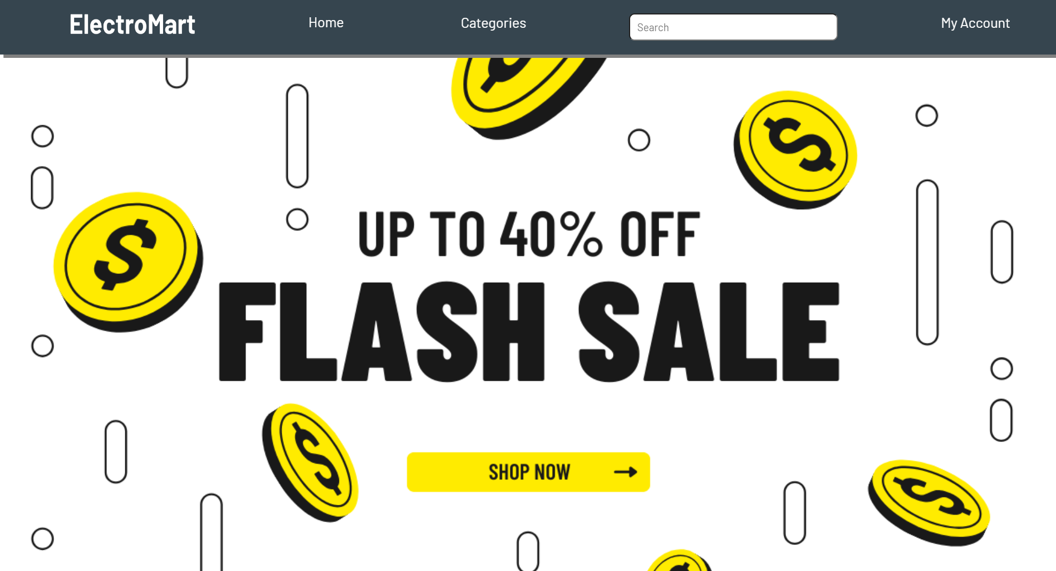
Project Highlights

Slide 8
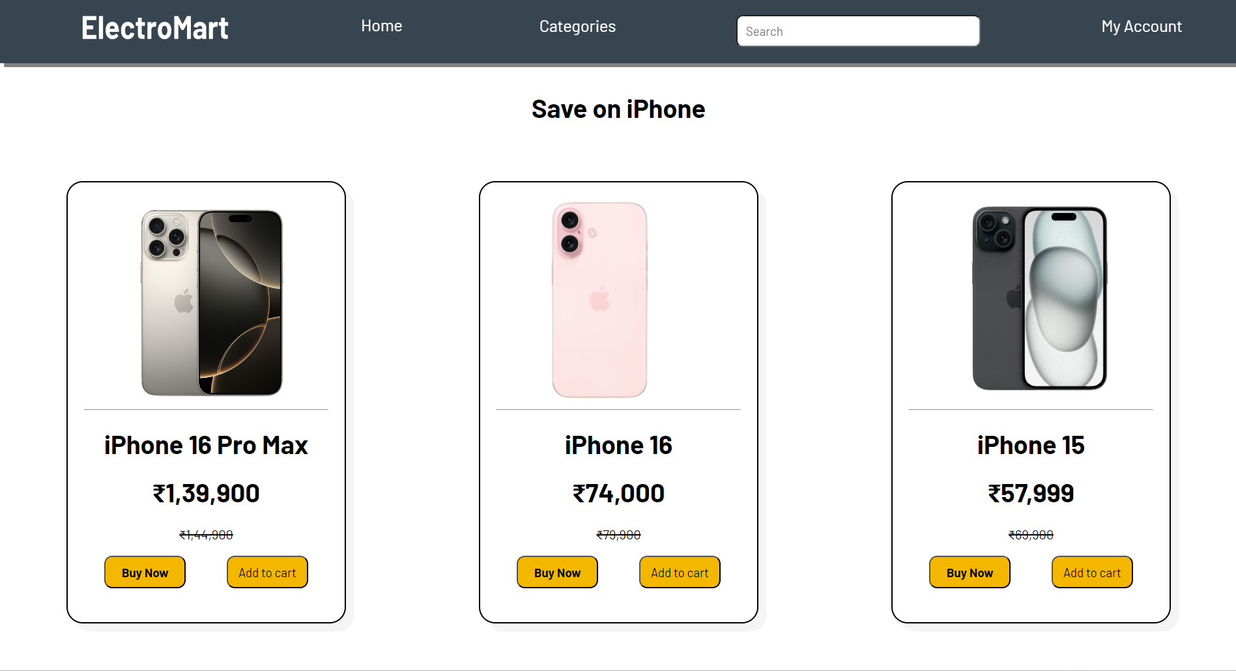
Project Higlights

Slide 9
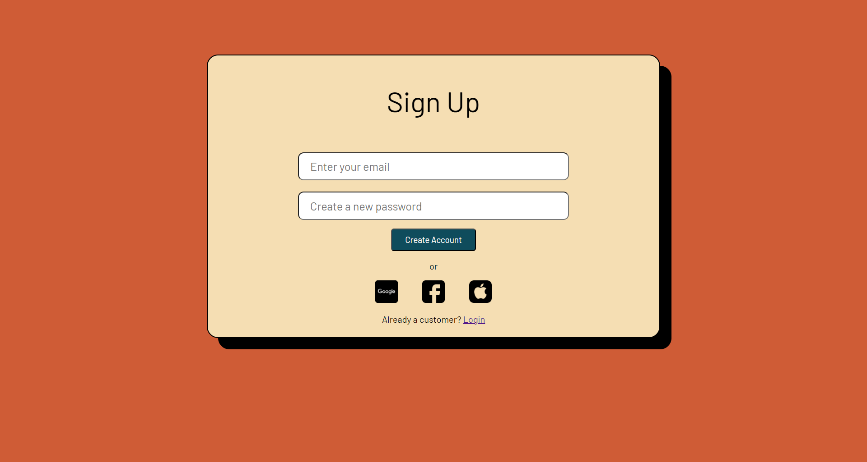
Project Higlights

Slide 10
Project Updates
Carousel: Using Bootstrap functionality
Alert: Whenever user creates an account or adds an item to cart, it shows an alert using JavaScript.
View More: Using BootStrap Modal, it enables the user to get details about the project
Required: the required attribute is used to ensure that a user cannot submit the form without filling in a particular input field.

Slide 11
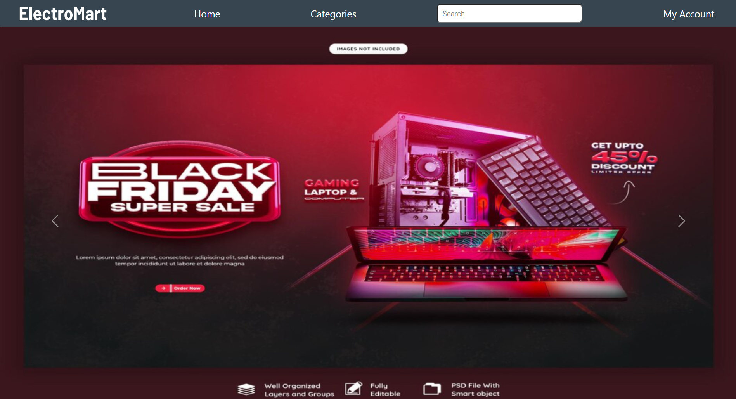
Project Updates

Slide 12
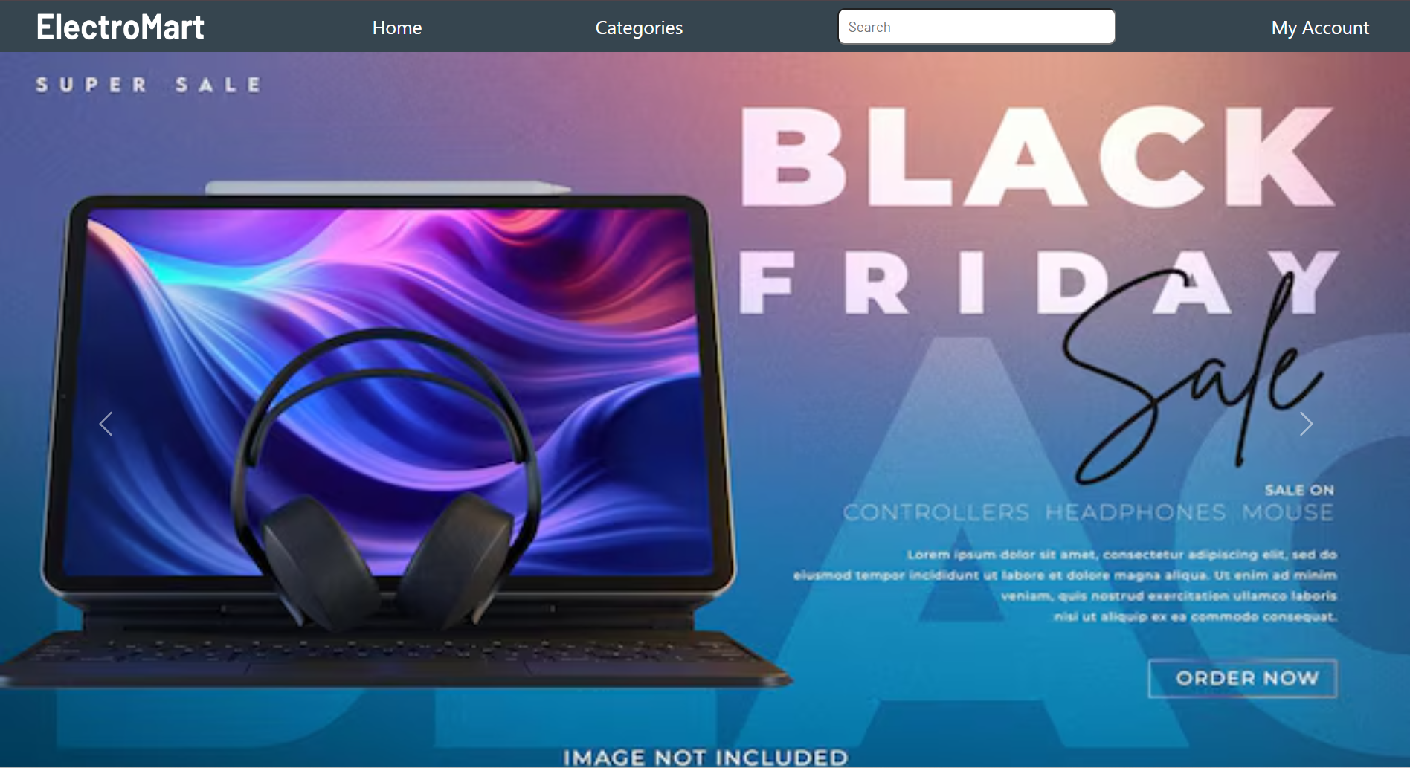
Project Updates

Slide 13
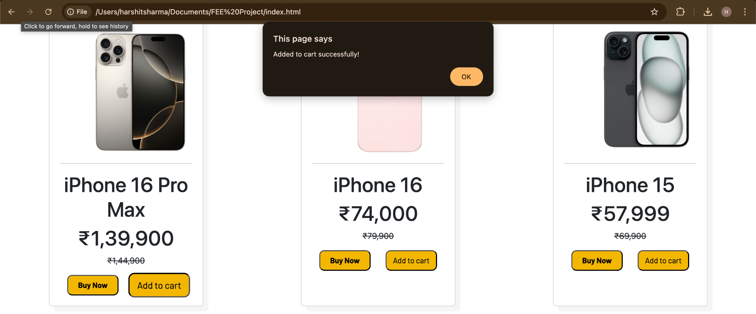
Project Updates

Slide 14
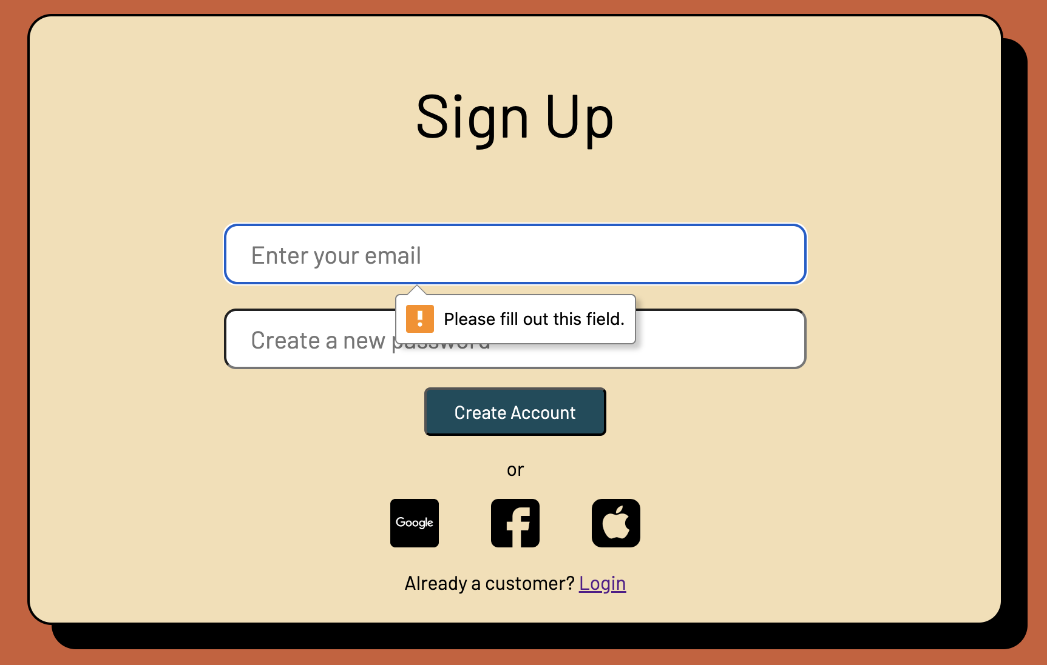
Project Updates

Slide 15
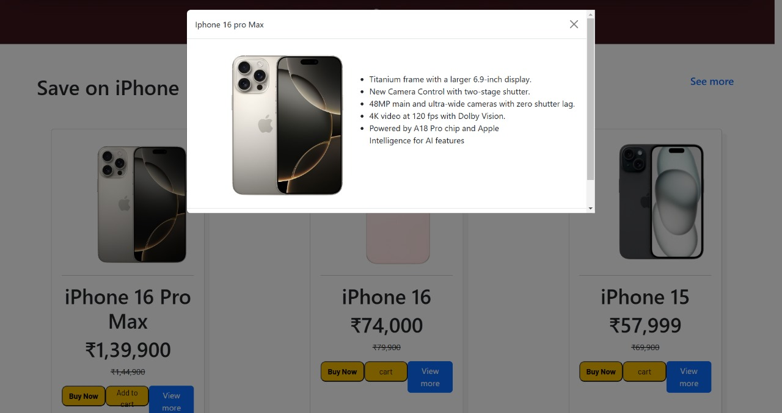
Project Updates

Slide 16
References/links
https://www.w3schools.com/
https://www.flaticon.com
https://www.freepik.com
https://getbootstrap.com/

Slide 17


